Slide 1
Building Java Programs Chapter 4
Conditional Execution
Copyright (c) Pearson 2013. All rights reserved.

Slide 2
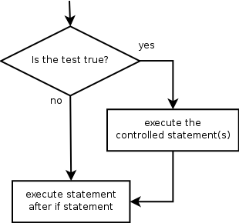
The if statement
Executes a block of statements only if a test is true
if (test) {
statement;
...
statement;
}
Example:
double gpa = console.nextDouble();
if (gpa >= 2.0) {
System.out.println("Application accepted.");
}

Slide 3
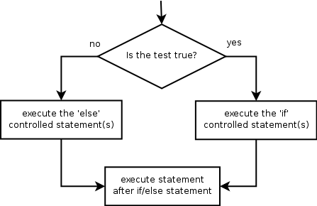
The if/else statement
Executes one block if a test is true, another if false
if (test) {
statement(s);
} else {
statement(s);
}
Example:
double gpa = console.nextDouble();
if (gpa >= 2.0) {
System.out.println("Welcome to Mars University!");
} else {
System.out.println("Application denied.");
}

Slide 4
Relational expressions
if statements and for loops both use logical tests.
for (int i = 1; i <= 10; i++) { ...
if (i <= 10) { ...
These are boolean expressions, seen in Ch. 5.
Tests use relational operators:
Operator | Meaning | Example | Value
== | equals | 1 + 1 == 2 | true
!= | does not equal | 3.2 != 2.5 | true
< | less than | 10 < 5 | false
> | greater than | 10 > 5 | true
<= | less than or equal to | 126 <= 100 | false
>= | greater than or equal to | 5.0 >= 5.0 | true
Notes:
Note that == tests equality, not = . The = is used for the assignment operator!

Slide 5
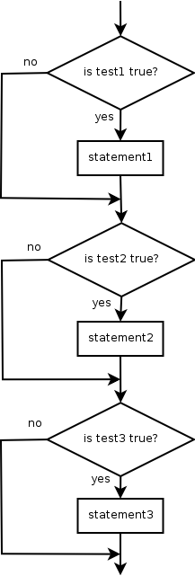
Misuse of if
What's wrong with the following code?
Scanner console = new Scanner(System.in);
System.out.print("What percentage did you earn? ");
int percent = console.nextInt();
if (percent >= 90) {
System.out.println("You got an A!");
}
if (percent >= 80) {
System.out.println("You got a B!");
}
if (percent >= 70) {
System.out.println("You got a C!");
}
if (percent >= 60) {
System.out.println("You got a D!");
}
if (percent < 60) {
System.out.println("You got an F!");
}
...

Slide 6
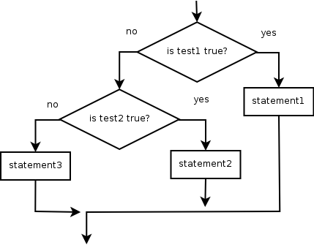
Nested if/else
Chooses between outcomes using many tests
if (test) {
statement(s);
} else if (test) {
statement(s);
} else {
statement(s);
}
Example:
if (x > 0) {
System.out.println("Positive");
} else if (x < 0) {
System.out.println("Negative");
} else {
System.out.println("Zero");
}

Slide 7
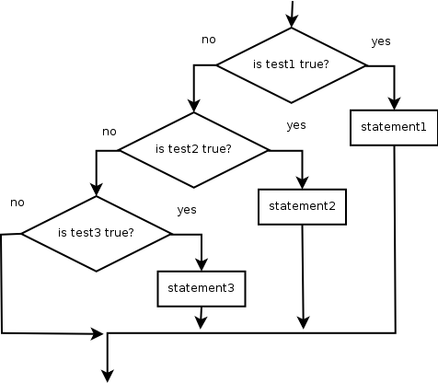
Nested if/else/if
If it ends with else, exactly one path must be taken.
If it ends with if, the code might not execute any path.
if (test) {
statement(s);
} else if (test) {
statement(s);
} else if (test) {
statement(s);
}
Example:
if (place == 1) {
System.out.println("Gold medal!");
} else if (place == 2) {
System.out.println("Silver medal!");
} else if (place == 3) {
System.out.println("Bronze medal.");
}

Slide 8
Nested if structures
exactly 1 path (mutually exclusive) if (test) { statement(s); } else if (test) { statement(s); } else { statement(s); } | 0 or 1 path (mutually exclusive) if (test) { statement(s); } else if (test) { statement(s); } else if (test) { statement(s); }
0, 1, or many paths (independent tests; not exclusive) if (test) { statement(s); } if (test) { statement(s); } if (test) { statement(s); }

Slide 9
Which nested if/else?
(1) if/if/if (2) nested if/else (3) nested if/else/if
Whether a user is lower, middle, or upper-class based on income.
(2) nested if / else if / else
Whether you made the dean's list (GPA ≥ 3.8) or honor roll (3.5-3.8).
(3) nested if / else if
Whether a number is divisible by 2, 3, and/or 5.
(1) sequential if / if / if
Computing a grade of A, B, C, D, or F based on a percentage.
(2) nested if / else if / else if / else if / else

Slide 10
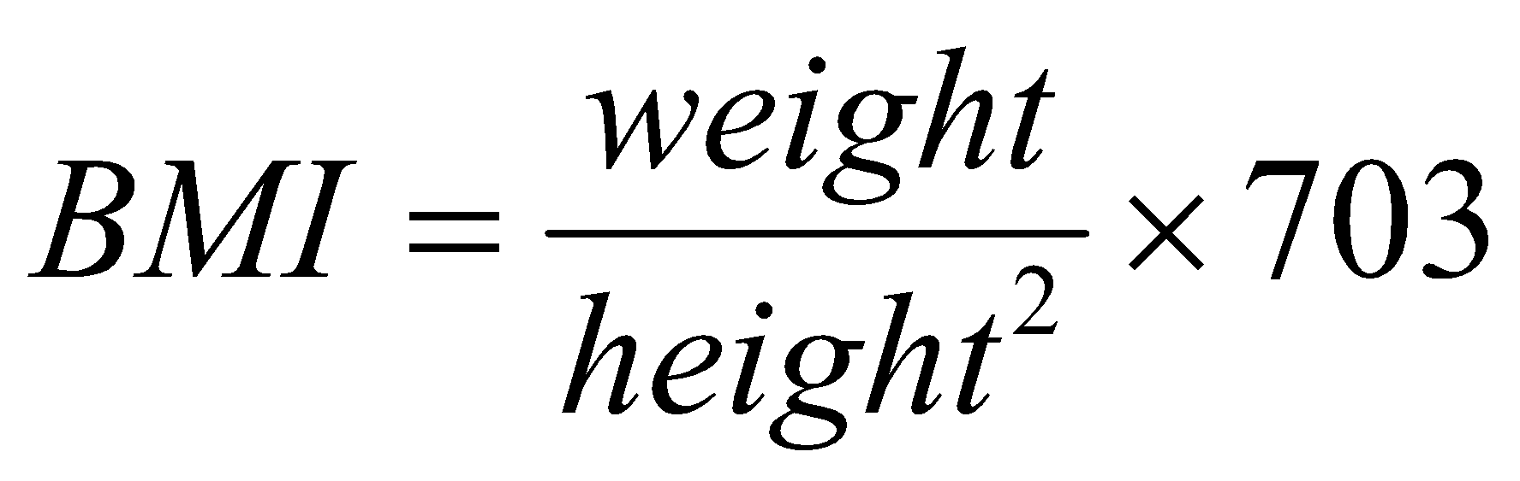
Nested if/else question
Formula for body mass index (BMI):
Write a program that produces output like the following:
This program reads data for two people and
computes their body mass index (BMI).
Enter next person's information:
height (in inches)? 70.0
weight (in pounds)? 194.25
Enter next person's information:
height (in inches)? 62.5
weight (in pounds)? 130.5
Person 1 BMI = 27.868928571428572
overweight
Person 2 BMI = 23.485824
normal
Difference = 4.3831045714285715
BMI | Weight class
below 18.5 | underweight
18.5 - 24.9 | normal
25.0 - 29.9 | overweight
30.0 and up | obese
Notes:
// This program computes two people's body mass index (BMI) and
// compares them. The code uses parameters, returns, and Scanner.
import java.util.*; // so that I can use Scanner
public class BMI {
public static void main(String[] args) {
System.out.println("This program reads in data for two people and");
System.out.println("computes their body mass index (BMI)");
System.out.println();
// finish me!
}
}

Slide 11
Nested if/else answer
// This program computes two people's body mass index (BMI) and
// compares them. The code uses Scanner for input, and parameters/returns.
import java.util.*; // so that I can use Scanner
public class BMI {
public static void main(String[] args) {
introduction();
Scanner console = new Scanner(System.in);
double bmi1 = person(console);
double bmi2 = person(console);
// report overall results
report(1, bmi1);
report(2, bmi2);
System.out.println("Difference = " + Math.abs(bmi1 - bmi2));
}
// prints a welcome message explaining the program
public static void introduction() {
System.out.println("This program reads data for two people and");
System.out.println("computes their body mass index (BMI).");
System.out.println();
}
...

Slide 12
Nested if/else, cont'd.
// reads information for one person, computes their BMI, and returns it
public static double person(Scanner console) {
System.out.println("Enter next person's information:");
System.out.print("height (in inches)? ");
double height = console.nextDouble();
System.out.print("weight (in pounds)? ");
double weight = console.nextDouble();
System.out.println();
double bodyMass = bmi(height, weight);
return bodyMass;
}
// Computes/returns a person's BMI based on their height and weight.
public static double bmi(double height, double weight) {
return (weight * 703 / height / height);
}
// Outputs information about a person's BMI and weight status.
public static void report(int number, double bmi) {
System.out.println("Person " + number + " BMI = " + bmi);
if (bmi < 18.5) {
System.out.println("underweight");
} else if (bmi < 25) {
System.out.println("normal");
} else if (bmi < 30) {
System.out.println("overweight");
} else {
System.out.println("obese");
}
}
}
Notes:
How would we round the BMI numbers?

Slide 13
Scanners as parameters
If many methods need to read input, declare a Scanner in main and pass it to the other methods as a parameter.
public static void main(String[] args) {
Scanner console = new Scanner(System.in);
int sum = readSum3(console);
System.out.println("The sum is " + sum);
}
// Prompts for 3 numbers and returns their sum.
public static int readSum3(Scanner console) {
System.out.print("Type 3 numbers: ");
int num1 = console.nextInt();
int num2 = console.nextInt();
int num3 = console.nextInt();
return num1 + num2 + num3;
}

Slide 14
Logical operators
Tests can be combined using logical operators:
"Truth tables" for each, used with logical values p and q:
Operator | Description | Example | Result
&& | and | (2 == 3) && (-1 < 5) | false
|| | or | (2 == 3) || (-1 < 5) | true
! | not | !(2 == 3) | true
p | q | p && q | p || q
true | true | true | true
true | false | false | true
false | true | false | true
false | false | false | false
p | !p
true | false
false | true

Slide 15
Evaluating logic expressions
Relational operators have lower precedence than math.
5 * 7 >= 3 + 5 * (7 - 1)
5 * 7 >= 3 + 5 * 6
35 >= 3 + 30
35 >= 33
true
Relational operators cannot be "chained" as in algebra.
2 <= x <= 10
true <= 10 (assume that x is 15)
error!
Instead, combine multiple tests with && or ||
2 <= x && x <= 10
true && false
false

Slide 16
Logical questions
What is the result of each of the following expressions?
int x = 42;
int y = 17;
int z = 25;
y < x && y <= z
x % 2 == y % 2 || x % 2 == z % 2
x <= y + z && x >= y + z
!(x < y && x < z)
(x + y) % 2 == 0 || !((z - y) % 2 == 0)
Answers: true, false, true, true, false
Exercise: Write a program that prompts for information about a person and uses it to decide whether to date them.

Slide 17
Factoring if/else code
factoring: Extracting common/redundant code.
Can reduce or eliminate redundancy from if/else code.
Example:
if (a == 1) {
System.out.println(a);
x = 3;
b = b + x;
} else if (a == 2) {
System.out.println(a);
x = 6;
y = y + 10;
b = b + x;
} else { // a == 3
System.out.println(a);
x = 9;
b = b + x;
}
System.out.println(a);
x = 3 * a;
if (a == 2) {
y = y + 10;
}
b = b + x;

Slide 18
if/else with return
// Returns the larger of the two given integers.
public static int max(int a, int b) {
if (a > b) {
return a;
} else {
return b;
}
}
Methods can return different values using if/else
Whichever path the code enters, it will return that value.
Returning a value causes a method to immediately exit.
All paths through the code must reach a return statement.

Slide 19
All paths must return
public static int max(int a, int b) {
if (a > b) {
return a;
}
// Error: not all paths return a value
}
The following also does not compile:
public static int max(int a, int b) {
if (a > b) {
return a;
} else if (b >= a) {
return b;
}
}
The compiler thinks if/else/if code might skip all paths, even though mathematically it must choose one or the other.

Slide 20
if/else, return question
Write a method quadrant that accepts a pair of real numbers x and y and returns the quadrant for that point:
Example: quadrant(-4.2, 17.3) returns 2
If the point falls directly on either axis, return 0.
y+
quadrant 2
quadrant 1
x-
x+
quadrant 3
quadrant 4
y-

Slide 21
if/else, return answer
public static int quadrant(double x, double y) {
if (x > 0 && y > 0) {
return 1;
} else if (x < 0 && y > 0) {
return 2;
} else if (x < 0 && y < 0) {
return 3;
} else if (x > 0 && y < 0) {
return 4;
} else { // at least one coordinate equals 0
return 0;
}
}

Slide 22
Cumulative algorithms

Slide 23
Adding many numbers
How would you find the sum of all integers from 1-1000?
// This may require a lot of typing
int sum = 1 + 2 + 3 + 4 + ... ;
System.out.println("The sum is " + sum);
What if we want the sum from 1 - 1,000,000? Or the sum up to any maximum?
How can we generalize the above code?

Slide 24
Cumulative sum loop
int sum = 0;
for (int i = 1; i <= 1000; i++) {
sum = sum + i;
}
System.out.println("The sum is " + sum);
cumulative sum: A variable that keeps a sum in progress and is updated repeatedly until summing is finished.
The sum in the above code is an attempt at a cumulative sum.
Cumulative sum variables must be declared outside the loops that update them, so that they will still exist after the loop.

Slide 25
Cumulative product
This cumulative idea can be used with other operators:
int product = 1;
for (int i = 1; i <= 20; i++) {
product = product * 2;
}
System.out.println("2 ^ 20 = " + product);
How would we make the base and exponent adjustable?

Slide 26
Scanner and cumul. sum
We can do a cumulative sum of user input:
Scanner console = new Scanner(System.in);
int sum = 0;
for (int i = 1; i <= 100; i++) {
System.out.print("Type a number: ");
sum = sum + console.nextInt();
}
System.out.println("The sum is " + sum);

Slide 27
Cumulative sum question
Modify the Receipt program from Ch. 2.
Prompt for how many people, and each person's dinner cost.
Use static methods to structure the solution.
Example log of execution:
How many people ate? 4
Person #1: How much did your dinner cost? 20.00
Person #2: How much did your dinner cost? 15
Person #3: How much did your dinner cost? 30.0
Person #4: How much did your dinner cost? 10.00
Subtotal: $75.0
Tax: $6.0
Tip: $11.25
Total: $92.25

Slide 28
Cumulative sum answer
// This program enhances our Receipt program using a cumulative sum.
import java.util.*;
public class Receipt2 {
public static void main(String[] args) {
Scanner console = new Scanner(System.in);
double subtotal = meals(console);
results(subtotal);
}
// Prompts for number of people and returns total meal subtotal.
public static double meals(Scanner console) {
System.out.print("How many people ate? ");
int people = console.nextInt();
double subtotal = 0.0; // cumulative sum
for (int i = 1; i <= people; i++) {
System.out.print("Person #" + i +
": How much did your dinner cost? ");
double personCost = console.nextDouble();
subtotal = subtotal + personCost; // add to sum
}
return subtotal;
}
...

Slide 29
Cumulative answer, cont'd.
...
// Calculates total owed, assuming 8% tax and 15% tip
public static void results(double subtotal) {
double tax = subtotal * .08;
double tip = subtotal * .15;
double total = subtotal + tax + tip;
System.out.println("Subtotal: $" + subtotal);
System.out.println("Tax: $" + tax);
System.out.println("Tip: $" + tip);
System.out.println("Total: $" + total);
}
}

Slide 30
if/else, return question
Write a method countFactors that returns the number of factors of an integer.
countFactors(24) returns 8 because 1, 2, 3, 4, 6, 8, 12, and 24 are factors of 24.
Solution:
// Returns how many factors the given number has.
public static int countFactors(int number) {
int count = 0;
for (int i = 1; i <= number; i++) {
if (number % i == 0) {
count++; // i is a factor of number
}
}
return count;
}

Slide 31
Text Processing

Slide 32
Type char
char : A primitive type representing single characters.
A String is stored internally as an array of char
String s = "Ali G.";
It is legal to have variables, parameters, returns of type char
surrounded with apostrophes: 'a' or '4' or '\n' or '\''
char letter = 'P';
System.out.println(letter); // P
System.out.println(letter + " Diddy"); // P Diddy
index | 0 | 1 | 2 | 3 | 4 | 5
value | 'A' | 'l' | 'i' | ' ' | 'G' | '.'

Slide 33
The charAt method
The chars in a String can be accessed using the charAt method.
accepts an int index parameter and returns the char at that index
String food = "cookie";
char firstLetter = food.charAt(0); // 'c'
System.out.println(firstLetter + " is for " + food);
You can use a for loop to print or examine each character.
String major = "CSE";
for (int i = 0; i < major.length(); i++) { // output:
char c = major.charAt(i); // C
System.out.println(c); // S
} // E

Slide 34
Comparing char values
You can compare chars with ==, !=, and other operators:
String word = console.next();
char last = word.charAt(word.length() - 1);
if (last == 's') {
System.out.println(word + " is plural.");
}
// prints the alphabet
for (char c = 'a'; c <= 'z'; c++) {
System.out.print(c);
}

Slide 35
char vs. int
Each char is mapped to an integer value internally
Called an ASCII value
'A' is 65 'B' is 66 ' ' is 32
'a' is 97 'b' is 98 '*' is 42
Mixing char and int causes automatic conversion to int.
'a' + 10 is 107, 'A' + 'A' is 130
To convert an int into the equivalent char, type-cast it.
(char) ('a' + 2) is 'c'

Slide 36
char vs. String
"h" is a String, but 'h' is a char (they are different)
A String is an object; it contains methods.
String s = "h";
s = s.toUpperCase(); // "H"
int len = s.length(); // 1
char first = s.charAt(0); // 'H'
A char is primitive; you can't call methods on it.
char c = 'h';
c = c.toUpperCase(); // ERROR
s = s.charAt(0).toUpperCase(); // ERROR
What is s + 1 ? What is c + 1 ?
What is s + s ? What is c + c ?
Notes:
‹#›

Slide 37
Formatting text with printf
System.out.printf("format string", parameters);
A format string can contain placeholders to insert parameters:
%d integer
%f real number
%s string
these placeholders are used instead of + concatenation
Example:
int x = 3;
int y = -17;
System.out.printf("x is %d and y is %d!\n", x, y);
// x is 3 and y is -17!
printf does not drop to the next line unless you write \n

Slide 38
printf width
%Wd integer, W characters wide, right-aligned
%-Wd integer, W characters wide, left-aligned
%Wf real number, W characters wide, right-aligned
...
for (int i = 1; i <= 3; i++) {
for (int j = 1; j <= 10; j++) {
System.out.printf("%4d", (i * j));
}
System.out.println(); // to end the line
}
Output:
1 2 3 4 5 6 7 8 9 10
2 4 6 8 10 12 14 16 18 20
3 6 9 12 15 18 21 24 27 30

Slide 39
printf precision
%.Df real number, rounded to D digits after decimal
%W.Df real number, W chars wide, D digits after decimal
%-W.Df real number, W wide (left-align), D after decimal
double gpa = 3.253764;
System.out.printf("your GPA is %.1f\n", gpa);
System.out.printf("more precisely: %8.3f\n", gpa);
Output:
your GPA is 3.3
more precisely: 3.254
3
8

Slide 40
printf question
Modify our Receipt program to better format its output.
Display results in the format below, with $ and 2 digits after .
Example log of execution:
How many people ate? 4
Person #1: How much did your dinner cost? 20.00
Person #2: How much did your dinner cost? 15
Person #3: How much did your dinner cost? 25.0
Person #4: How much did your dinner cost? 10.00
Subtotal: $70.00
Tax: $5.60
Tip: $10.50
Total: $86.10

Slide 41
printf answer (partial)
...
// Calculates total owed, assuming 8% tax and 15% tip
public static void results(double subtotal) {
double tax = subtotal * .08;
double tip = subtotal * .15;
double total = subtotal + tax + tip;
// System.out.println("Subtotal: $" + subtotal);
// System.out.println("Tax: $" + tax);
// System.out.println("Tip: $" + tip);
// System.out.println("Total: $" + total);
System.out.printf("Subtotal: $%.2f\n", subtotal);
System.out.printf("Tax: $%.2f\n", tax);
System.out.printf("Tip: $%.2f\n", tip);
System.out.printf("Total: $%.2f\n", total);
}
}

Slide 42
Comparing strings
Relational operators such as < and == fail on objects.
Scanner console = new Scanner(System.in);
System.out.print("What is your name? ");
String name = console.next();
if (name == "Barney") {
System.out.println("I love you, you love me,");
System.out.println("We're a happy family!");
}
This code will compile, but it will not print the song.
== compares objects by references (seen later), so it often gives false even when two Strings have the same letters.

Slide 43
The equals method
Objects are compared using a method named equals.
Scanner console = new Scanner(System.in);
System.out.print("What is your name? ");
String name = console.next();
if (name.equals("Barney")) {
System.out.println("I love you, you love me,");
System.out.println("We're a happy family!");
}
Technically this is a method that returns a value of type boolean, the type used in logical tests.

Slide 44
String test methods
Method | Description
equals(str) | whether two strings contain the same characters
equalsIgnoreCase(str) | whether two strings contain the same characters, ignoring upper vs. lower case
startsWith(str) | whether one contains other's characters at start
endsWith(str) | whether one contains other's characters at end
contains(str) | whether the given string is found within this one
String name = console.next();
if (name.startsWith("Prof")) { System.out.println("When are your office hours?"); } else if (name.equalsIgnoreCase("STUART")) { System.out.println("Let's talk about meta!"); }

